Slide 1
CSCI 7000 Intro to Enterprise Networks
Formerly TLEN5460 Telecom Sys Lab
Course Introduction
Fall 2021
Jose Santos

Slide 2
Fall 2022 Schedule
15 weeks
1 labs per week, 2 practical exams, 2 written exams
20-25hrs of effort (Per team**)
More equipment time
More support **
Material completion is more feasible

Slide 3
Grading policy (Refer to Canvas)
20% quizzes (Mondays.. This week on Wed)
10% lab write-ups
35% midterm
15% written
20% practical (15+5 Report) (Interview)
35% final
15% written
20% practical (15+5 Report) (Interview)

Slide 4
Why taking this course
In 12-14 weeks you’ll learn:
How to build
How to configure
How to troubleshoot
How to design

Slide 5
What we will offer
Lectures
Live
Additional lectures/discussions for topics such IP addressing, metro Ethernet, DMVPN, MPLS.
Office hours / the works
Instructor travel
Remote/Pre-recorded
Last Week Oct/First Nov

Slide 6
The payout
DO it for the knowledge not for the grade
No Grade averaging
Knowledge level/skill expected from the course
Not many chances to build ( and break) networks every single week.

Slide 7
This week
Quiz on Wednesday
10-15 Minutes
Protocol operation/integration during basic Internet Connection
Lab 0 (Friday)
Get Familiarized with lab environment
Team creation
Schedule team session.
Lab Etiquette
Respect lab environment
Cleanup, Seating, Equipment

Slide 8
Lab Slots
Determined by lab equipment availability
IP routing / Senior Capstone Projects / Advanced lab courseware
IP Routing (F 1:00 – Sat 5:00PM)
Advanced Lab (TBD)
Currently available from Sun 8AM – Fri @ 12:00PM
2 3hr slots ( cannot be the same day)
SA supervision required during initial labs
Mid September
Card access per team ( 1 lead)

Slide 9
Lab Assistants
Dinesh Palanivelu (TBD)
Sunny Bajaj (TBD)
Role:
Lead to answer
Interview during exams (take notes)
Check reports for completion
Office hours / During lab slots (TBD)
Whiteboard / Ancillary discussion/lecture

Slide 10
Succeeding in this course
Be proactive:
Read a chapter per day.
Read lab writeup ahead of time
Find configuration examples related to the technical concepts of the lab.
Maximize lab time in execution, not used for reading
Revisit materials after class
Isolate loose concepts
Make use of SA office hours
Practice with GNS and packet tracer (suggestion)

Slide 11
Course Topics
Ethernet Switching (VLAN, Spanning Tree, Layer 2 security, RSTP, Wireless LANs)
Efficient IP addressing designs (CIDR, VLSM)
LAN Routing (RIP, OSPF, Static, NAT/PAT, ACL)
Multi-tenancy and Load balancing (Virtual routing forwarding (VRF), HSRP, SNAT)
WAN Remote Access Technologies (MPLS, Metro Ethernet)
VPN architectures (IPsec, DMVPN)
IP next generation (IPv6) and transition methods (ISATAP, 6to4, GRE, and Teredo tunnels

Slide 12
Questions?

Slide 13
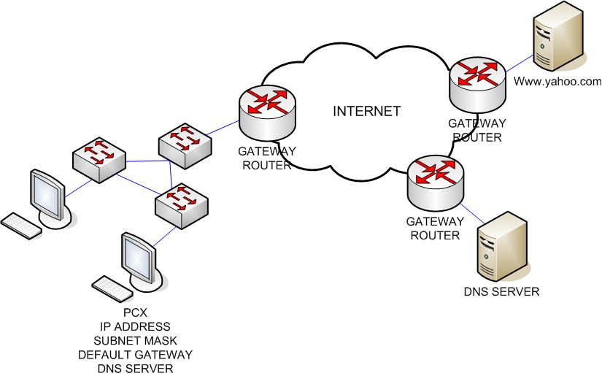
Network Process
Ping from PCX to www.yahoo.com

